Slide 1
Building an Active Directory Lab with Hyper-V

Slide 2
In this Video, we are going to take a look at…
Basic setup and walkthrough of Hyper-V
Notes:
This slide, like mentioned above is for multiple pointers. The information above covers the types of information that can be used in this slide

Slide 3
In this Video, we are going to take a look at…
Basic setup and walkthrough of Hyper-V
Setting up our Hyper-V lab
Notes:
This slide, like mentioned above is for multiple pointers. The information above covers the types of information that can be used in this slide

Slide 4
In this Video, we are going to take a look at…
Basic setup and walkthrough of Hyper-V
Setting up our Hyper-V lab
Power on the virtual machines and connect to them
Notes:
This slide, like mentioned above is for multiple pointers. The information above covers the types of information that can be used in this slide

Slide 5
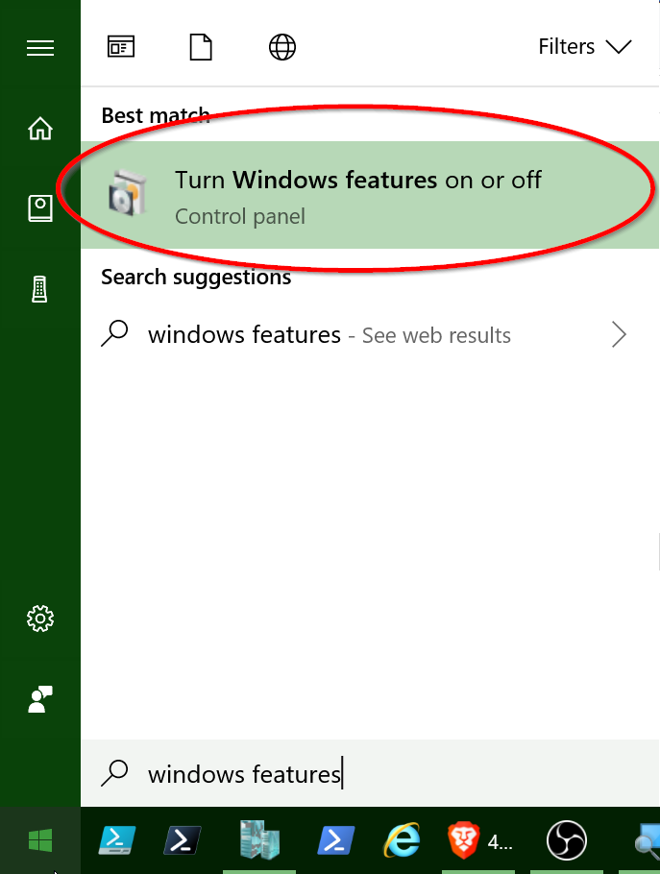
Windows Features

Slide 6
Installing the Server Operating Systems
Next Video

